Slide 1
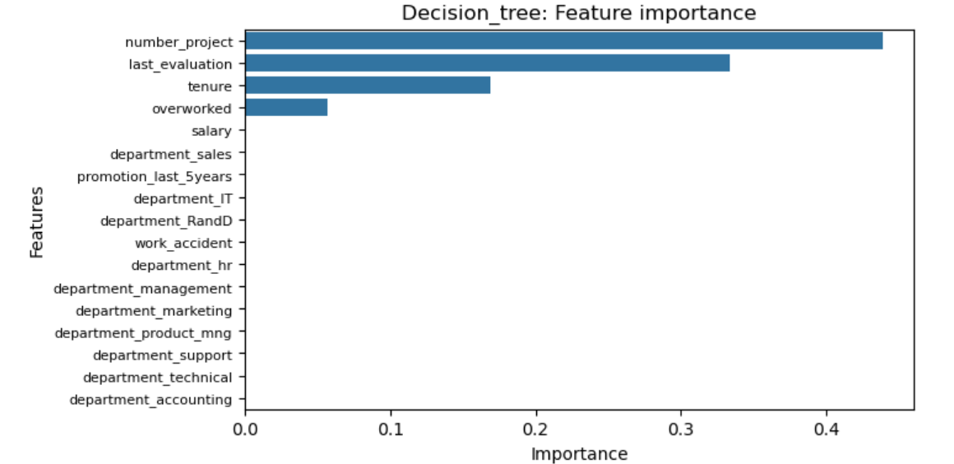
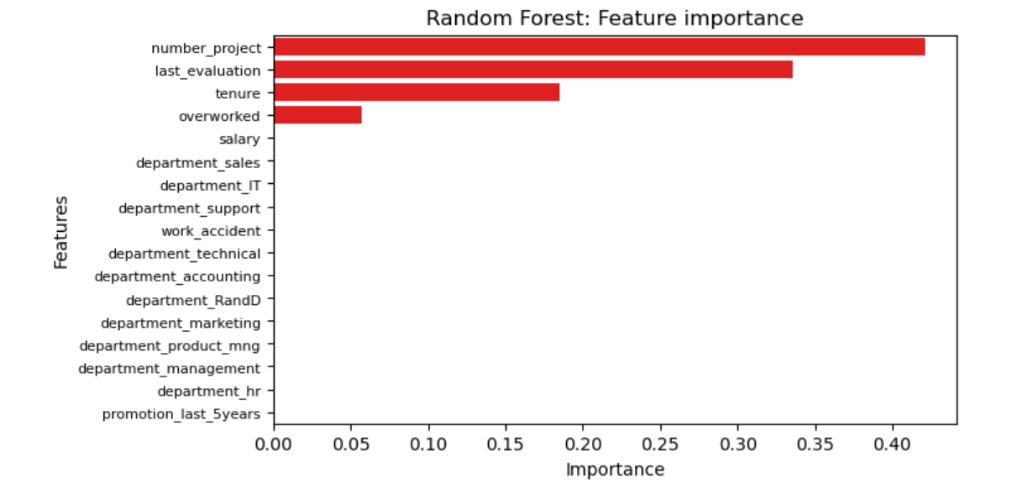
Mercedes Project
Employee retention prediction
Mercedes seeks to improve employee retention and answer:
What’s likely to make the Employees leave the company?
To address the problem we can use Logistic regression or tree based models as the target variable we want to predict is binary.
The random forest model slightly outperforms the decision tree model
Barplot showing number_project, last_evaluation, tenure, overworked as the most influential features
This model helps to predict which employees would leave and the most influencing feature that results in this outcome.
This will the hr team make decisions to improve employee retention
In random forest also the same set of the features are the most in predicting the outcome of what makes employees leave.
The number of projects should be reduced.
The employees having to work overtime (more then 200 hours per month) should be rewarded in a proper balanced manner throughout the different departments.
Promotion should be given to Employees working more than 4 years in the organization.
Meetings about the work culture should be held for the employees to better understand the functioning of the organization.
High evaluation scores should not be reserved for employees working more than 200 hours per month.

